Slide 1
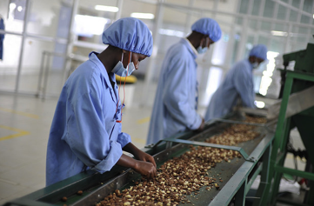
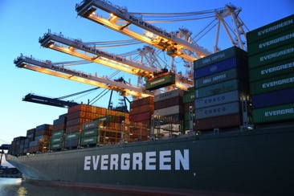
Southern Africa Trade and Investment Hub
Increased AGOA Utilization through USAID TradeHub Support
March 25, 2021

Slide 2
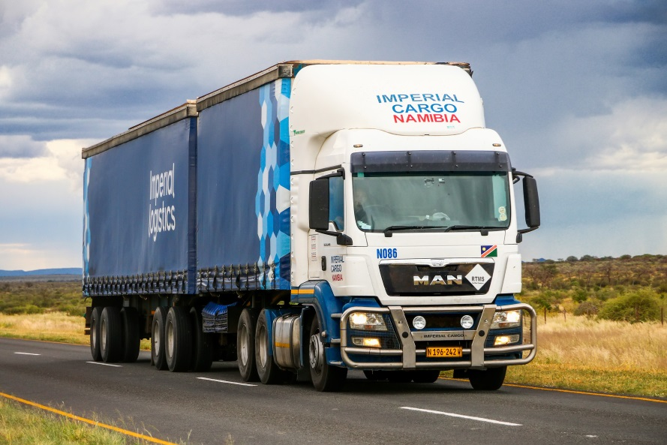
Presentation Outline
USAID TradeHub Overview and Strategic Objectives
USAID TradeHub Support Towards Sustainable Utilization of AGOA
Partnerships
Key Resources

Slide 3
USAID TradeHub Overview and Strategic Objectives

Slide 4
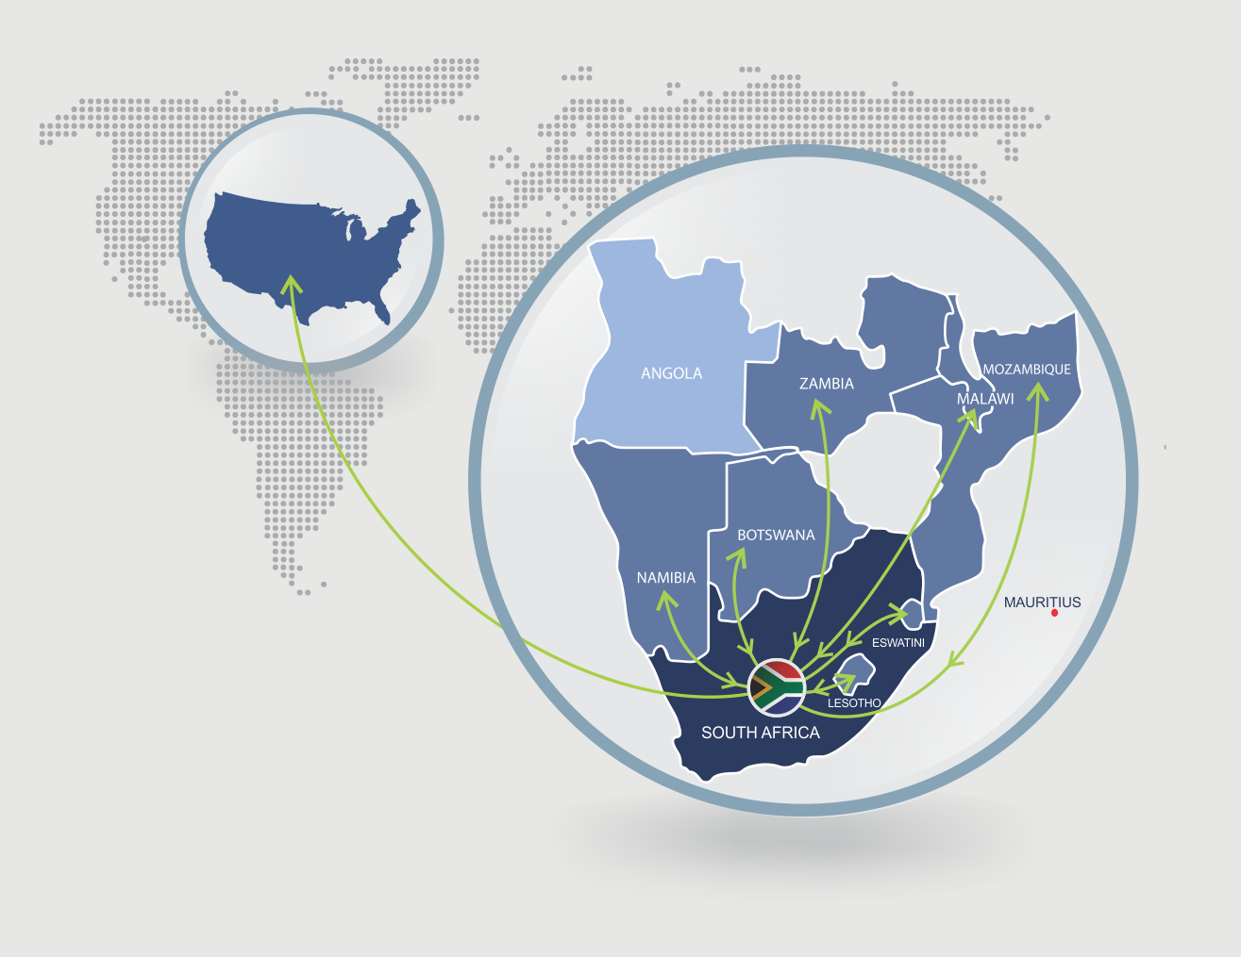
USAID TradeHub Objectives
The USAID TradeHub works to increase sustainable economic growth, global export competitiveness, and trade in Southern Africa by:
Increasing exports from Southern African countries to South Africa and the United States under the African Growth and Opportunity Act (AGOA).
Boosting capital and technology flows from South Africa to other southern African countries.

Slide 5
USAID TradeHub Support Towards Sustainable Utilization of AGOA

Slide 6
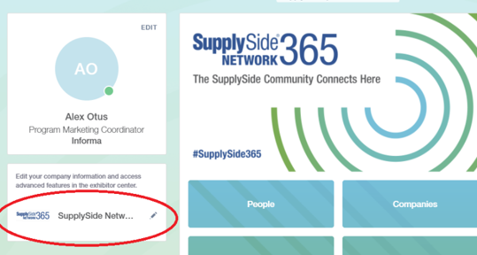
Engage Trade Promotion Service Providers to Support Online Listings
Albert Scott LLC/Amazon
Five firms supported in pilot; one from Eastern Cape (COTi
Chocolate)
21 firms in total to be supported in ‘First Wave’ (March 2021)
Targeting 19 firms in ‘Second Wave’ (April-June 2021)
Informa Markets
Listing ingredients suppliers on SupplySide Network
365 platform
Organic Trade Association (OTA, USA)
Joint Organics webinar with Ecocert Southern Africa
Listing U.S. National Organic Program (NOP)
Certified companies in FindOrganic online directory
Others: Africa Trade Platform, Messe Frankfurt

Slide 7
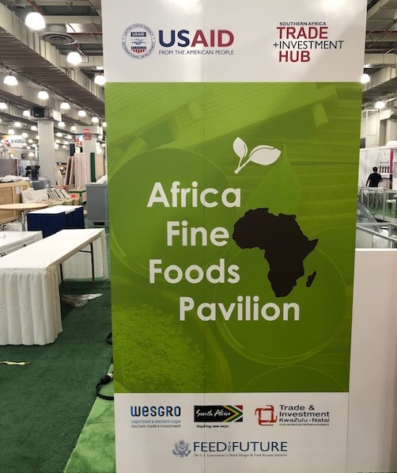
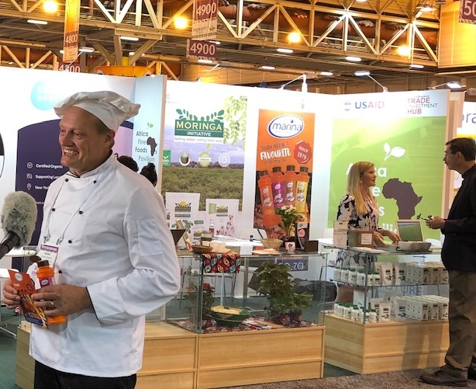
Trade Shows Participation
Specialty Food Live
COTi Chocolate
Institute of Food Technologists (IFT), 2019
Marina Sea Salt
Handbag & Leather Accessories event, Nov. 2020
MAGIC Show, August 2021
Summer Fancy Food Show, September 27-29, 2021
All Fashion (Cape Town)

Slide 8
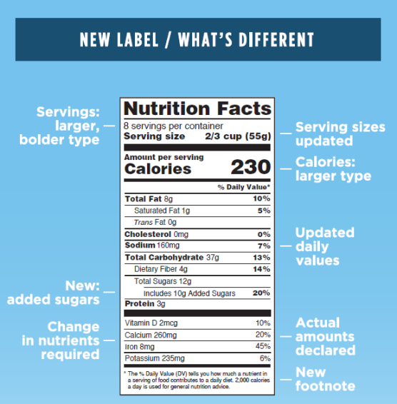
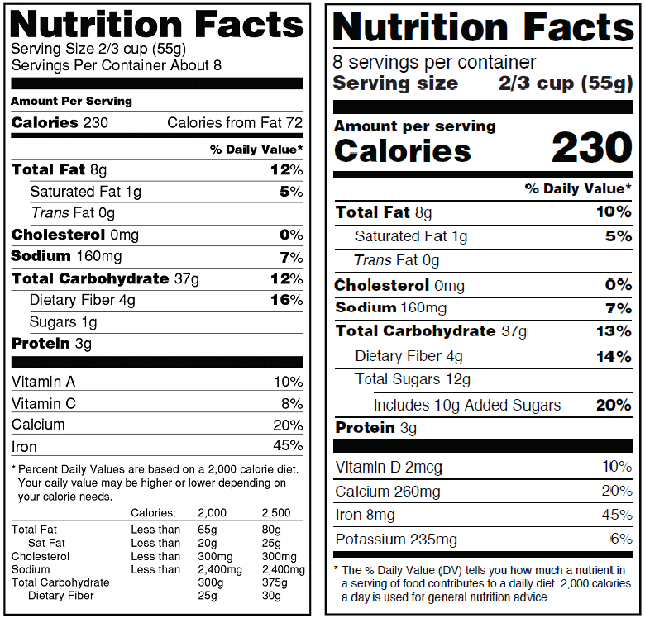
U.S. FDA Compliance
Food and Drug Administration (FDA) Registration
FDA Labeling Review

Slide 9
U.S. Buyer-Seller Linkages
Ontdek
Linkages with U.S. retailers and distributors
FFF Associates
Linkages with U.S. ingredients importers: food and cosmetics ingredients
Bhavana World Projects
Linkages with U.S. textiles and apparel buyers
Market Linkages Specialist: Andres Saldias
Linkages with U.S. textiles and apparel buyers

Slide 10
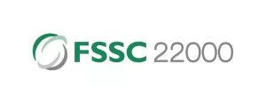
U.S. Recognized Certifications
Organic Certification
National Organic Program (US)
Food Safety Certifications
FSSC22000
British Retail Consortium (BRC)
Partners: Ceres-Cert, Ecocert Southern Africa, Intertek, BSI

Slide 11
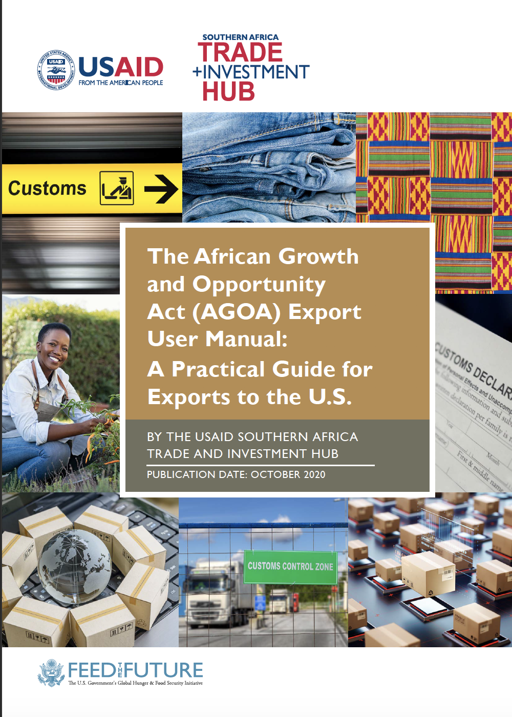
Tools and Systems
AGOA Export User Manual and factsheets
developed and shared
Video on AGOA export process
(a series of four 3-4 min videos)
to be developed disseminated via partners
(ECDC, Wesgro, NMBBC and BKCOB)
Handmade e-Lookbook
featuring arts and craft firms
shared with U.S. buyers
AGOA Utilization Strategies
Webinar recordings available on www.satihub.com
Information on AGOA, U.S. food safety compliance, food labelling and more. Shared with firms that enquire about U.S. export on a frequent basis.

Slide 12
Partnerships

Slide 13
Strategic Partners (U.S.)
South African Consulate General (SACG) Collaborate on trade events Engages with U.S. buyers
Specialty Food Association (SFA) Specialty foods partner Organizes Summer Fancy Food Show, Specialty Food Live! Events Information-sharing on food trends
American Apparel & Footwear Association (AAFA) Apparel and footwear partners U.S. apparel and footwear markets awareness
Organic Trade Association (OTA) U.S. organic market awareness Listing NOP certified firms in online directory
Technical TPSPs Albert Scott LLC FFF Associates Informa Markets U.S. Import Agent (USIA) Inc | Bhavana World Projects Ontdek Nazaru LLC Registrar Corp

Slide 14
Strategic Partners (Regional)
SA Partners
Trade & Investment Promotion Agencies
Eastern Cape Development Corporation
Gauteng Growth & Development Agency
Mpumalanga Economic Growth Agency
Trade & Investment Kwa-Zulu Natal
Wesgro
BMOs
AmCham
Border-Kei Chamber of Business
Johannesburg Chamber of Commerce
Nelson Mandela Bay Business Chamber
Technical TPSPs
Ecocert South Africa
Ceres-Cert
BSI
Intertek
Regional Partners
Botswana Investment & Trade Center
Botswana Exporters & Manufacturers Association
Eswatini Investment Promotion Authority (EIPA)
Lesotho National Development Corporation
Malawi Confederation of Chambers of Commerce & Industry
Malawi Investment & Trade Centre
Confederação das Associações Económicas de Moçambique - CTA
Investment & Export Promotion Agency of Mozambique
Namibia Chamber of Commerce & Industry
Zambia Association of Manufacturers
Zambia Development Agency

Slide 15
Key Resources

Slide 16
Key Resources
African Growth & Opportunity Act: http://trade.gov/agoa | www.agoa.info
Frequently Asked Questions: https://agoa.info/about-agoa/faq.html
List of AGOA eligible products: https://agoa.info/about-agoa/products.html
U.S. Trade Representative: www.ustr.gov
Trade Law Centre: www.tralac.org
U.S. International Trade Commission: www.usitc.gov
U.S. Food and Drug Administration: www.fda.gov
U.S. Department of Commerce: www.doc.gov
Office for Textiles and Apparel: http://otexa.ita.doc.gov
International Trade Administration: www.trade.gov
U.S. Department of Agriculture: www.usda.gov
U.S. Customs and Border Protection: www.cbp.gov
Specialty Food Association: www.specialtyfood.com
Organic Trade Association: https://ota.com
American Apparel & Footwear Association: www.aafaglobal.org
USAID TradeHub: www.satihub.com

Slide 17
Thank You
Cos Mamhunze
Portfolio Manager | South Africa
USAID Southern Africa Trade and Investment Hub (USAID TradeHub)
Implementing Partner
Pretoria, South Africa
Email: cosmas_mamhunze@satihub.com
Skype: cos.mam
www.satihub.com

