Slide 1
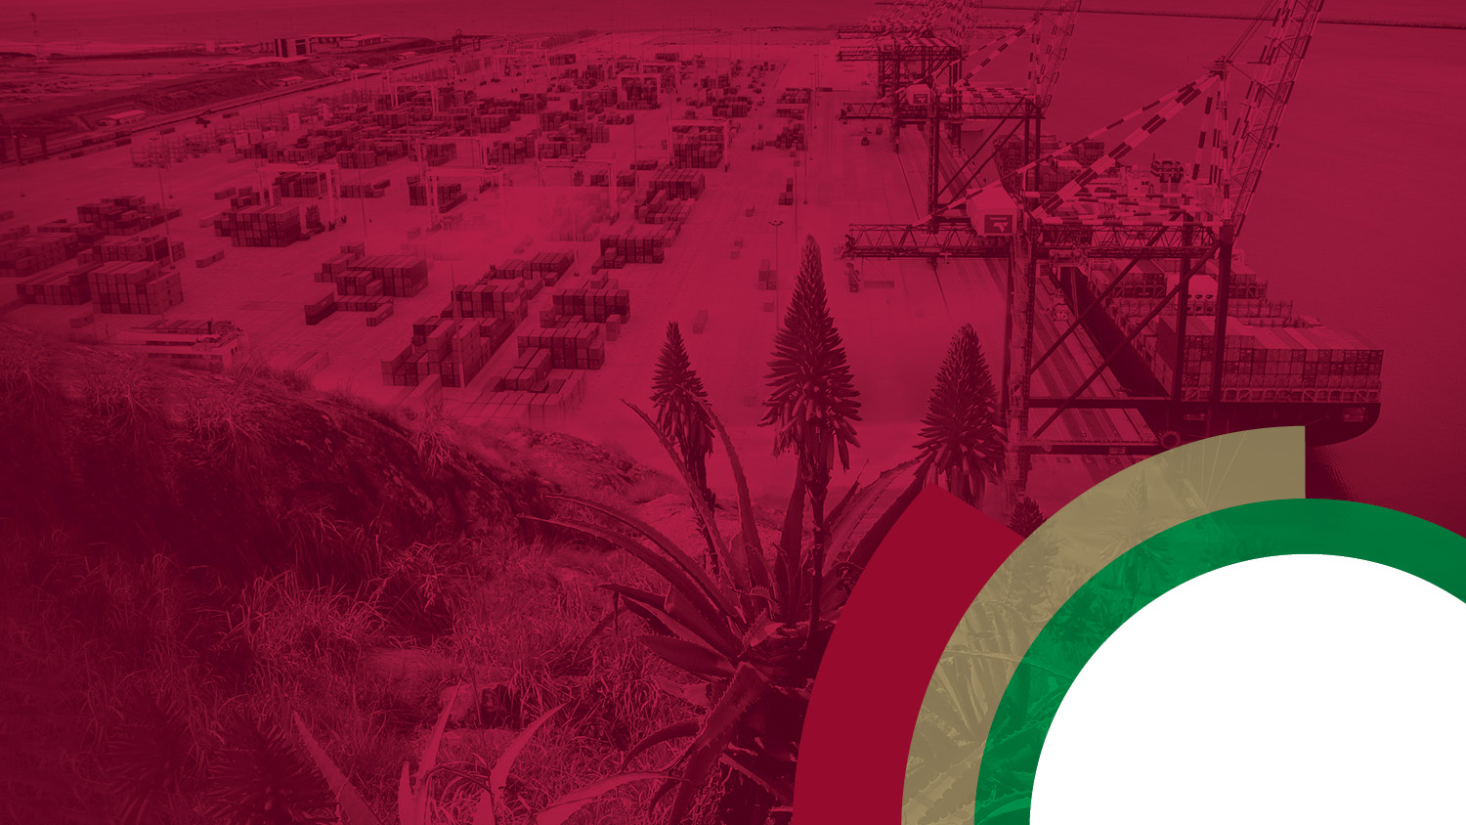

Eastern Cape Provincial Economic Recovery Plan
24 March 2021
Akho Skenjana

Slide 2
Table of Contents
Situation Analysis and Economic Outlook
National Economic Reconstruction and Recovery Plan
Provincial Five-point plan for economic recovery
Implementation Plan
Conclusion

Slide 3
ECONOMIC OUTLOOK
The COVID-19 outbreak has had major effects on economic performance, social and health systems globally.
According to the Q4 Economic Review (Statssa):
  Global growth forecasts have been revised to -3.5% in 2020 and 5.5% for 2021. The South African economy is forecasted to grow by 2.8% in 2021 by the IMF.
  The South African economy expanded by 6.3% with manufacturing, trade and transport industries being the largest contributors to GDP growth.
Notes:
Manufacturing driven by Food & Beverages, Auto sector & Steel (Nationally). Province strong on Food and Auto

Slide 4
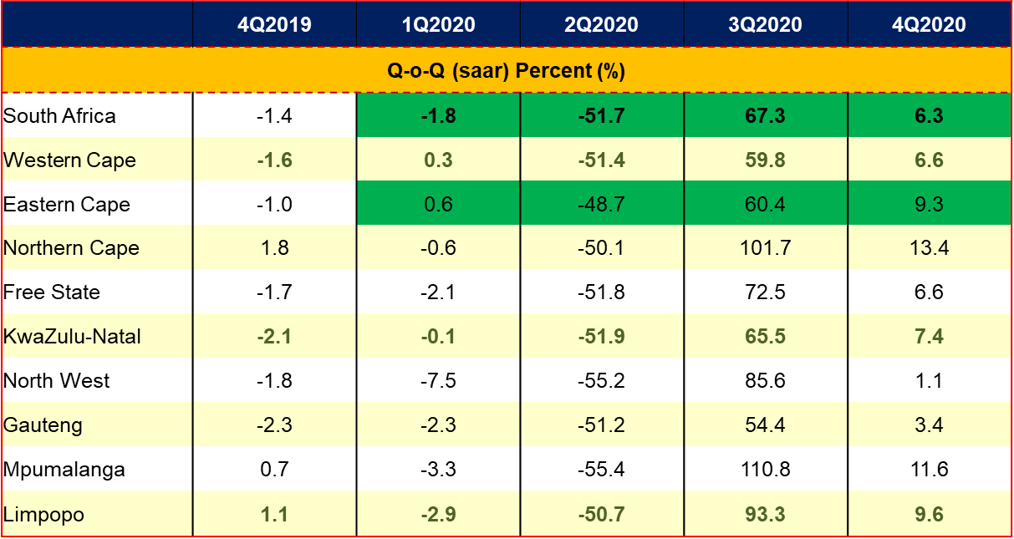
Overview – Economic Outlook
GDPR Growth Performance per Province
Source: Quantec research & calculations

Slide 5
Overview – Economic Outlook
GDPR Growth Performance per Province
Source: StatsSA, Quantec research & calculations

Slide 6
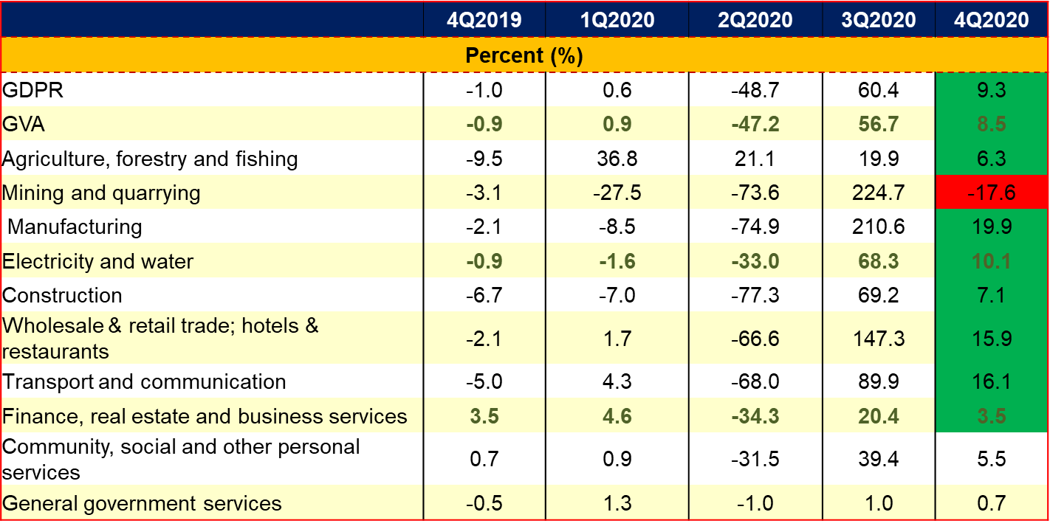
Sector Growth as measured by Gross Value-added
All industries contributed positively to provincial GDP, except for mining.
Key Sector growth rates:
  Manufacturing
  Transport & Communication
  Wholesale & trade
  Electricity
  Construction
  Agriculture
Source: Quantec research

Slide 7
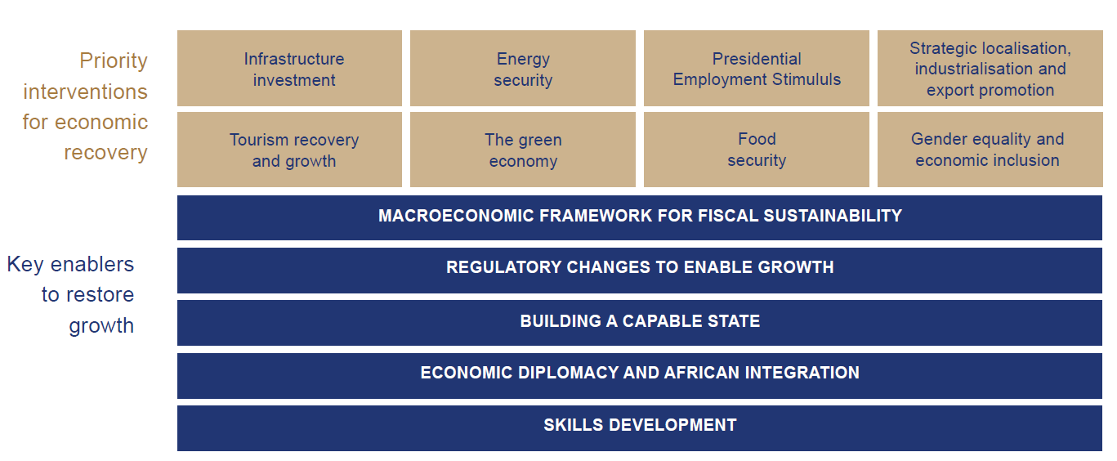
RECONSTRUCTION AND RECOVERY PLAN

Slide 8
FIVE-POINT PLAN FOR ECONOMIC RECOVERY OF THE EASTERN CAPE
Infrastructure Development
Industrialization and Sector development
Equitable, Inclusive Transformation.
Digital Transformation
Public Finances
Infrastructure at heart of economic recovery: Strengthening provincial project packaging & implementation capacity.
Drive re-industrailization through provincial catalytic projects & rural initiatives based on unique strengths & potentials of the province (Calibrate PEDS for new reality).
Build Equitable & Inclusive Economy through SMMEs, Township Economies, Informal Sector, and Social Economy
Elevate the strategic role of Broadband Infrastructure; Ensure skills, capacity and access for connected and digitally included SMMEs and Entrepreneurs.
Mobilize public investment as a lever for growth; investor mobilization.
Five point plan built on the objectives of economic growth and job creation.

Slide 9
Provincial Economic Recovery Plan Framework for implementation
Goals
Economic Growth
Job Creation
5-Point Plan
Infrastructure Development
Industrialisation
Inclusive Growth
Digital Economy
Public Finance
Key Result Areas
Ensure rollout of critical economic infrastructure
Provincial Support to distress businesses and farmers
Consider & provide local incentives that promote retention of investors
Support SMMEs, Business Enterprises, Farmers & Informal Traders for relief
Smart Marketing Initiatives
Compliance with OHSA-Covid 19 protocol
Interventions
Project packaging and resource mobilization
Sector support and development
Business continuity
SMME support and incubation roll-out
Broadband infrastructure and digital platforms roll-out
Business support and compliance
Inputs and Resources
Budget
Project Commissioning
Technical Assistance

Slide 10
1. Infrastructure Development
Economic Infrastructure as an enabler
Special Economic Zones – 3 platforms
Industrial Parks – 6 parks
Regional infrastructure projects
Provision for sectors that account for a growing share of production and employment
  Unlock bottlenecks to jumpstart and accelerate the implementation of the provincial economic catalytic projects, such as: Mzimvubu Multipurpose project, Project Mthombo, Gas-to-Power, Ngqura Transhipment Hub, Relocation of Manganese terminal from the PE port to Ngqura
  Aggressively access National Large infrastructure funding (BFI and SIDS)

Slide 11
2. Industrialisation (Recalibrate PEDS)
Agri-Industry
Roll-out agriculture economic transformation strategy
Automotive and Manufacturing
Upscale Jobs Stimulus Fund
Development of local manufacturing capacity
Implement Agro industry development action plan
Build local value chains
Industry intelligence
Strengthen industry cluster
LED Procurement programme
SMME support programmes

Slide 12
2. Industrialisation (continued)
Tourism
Tourism Economic Recovery Plan
Oceans Economy
Accelerate implementation of Provincial Aquaculture Development Strategy
Position three provincial ports for resurgence of Global Value Chains (GVCs)
Strengthen collaborations with industry (SAMSA, SAIMI, NMU Oceans Sciences & international shipping lines) for value chains development in the Offshore Bunkering Industry and Maritime Transport Industry
Roll-out Oceans Economy Master Plan
Brand development and marketing
SMME development
Industry support
Strengthen collaborations with industry for sector growth and development

Slide 13
3. Digital Economy through Science, Technology and Innovation (Post-COVID New Normal): Interventions include:
Coastal Data Cable Landfall Station,
Business Process Outsourcing Facility
Document Storage Facility
Support Industrial Research and Innovation interventions
Implement major re-skilling and up-skilling interventions to deal with the emerging post-COVID ‘Work-from-Home’ trend affecting many industries

Slide 14
4. SMME Support (Equitable & Inclusive Growth)
Build and strengthen collaborations with SMME sector stakeholders for focussed support programme
Fund Implementation of Enterprise Incubation and Development focusing on manufacturing and aquaculture sectors
Strengthen collaboration and integration between National Relief Instruments and Provincial and Local Government to enhance access to national and provincial relief funds by SMMEs and informal traders.

Slide 15
5. Development Finance and Stimulus Funding (Building viable fiscal economy to finance growth)
Investor Mobilisation
Participate in National Investment Conference
Convene Provincial Investment Conference
Host Export Symposium
Leverage Private Capital
Create Provincial Sovereign Wealth Fund
Development Finance & Business Support
Provide fiscal stimulus through the following instruments:
Jobs Stimulus Fund,
LRED Fund,
Isiqalo Youth Fund,
Imvaba Fund
Economic Stimulus Fund

Slide 16
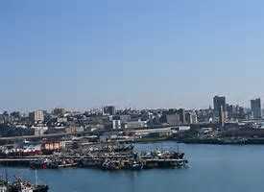
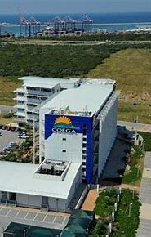
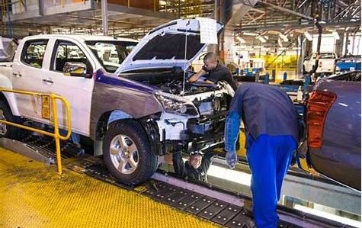
Economy Recovery:
Immediate and Medium-Term Responses by Sectors

Slide 17



Sector Response:
Auto & Non-Auto Manufacturing Sectors
Interventions | Status
Strengthened relations with Industry Clusters | Operational
Maintain the Manufacturing Support Centre for distress manufacturing companies and ensure maximum participation in ECDC Job stimulus fund instrument | Operational
Implementation of COVID19 Distressed portal | Operational
Support with the development of PPE manufacturing capacity | Operational
Roll-out Jobs Stimulus Fund | Operational

Slide 18
Agriculture and Agro Processing
Intervention | Status
Develop and roll-out enablers for primary production ramp up | Operational
Agricultural industry cluster development | Operational
Development of sector funding scheme for value chains | Development

Slide 19
Agriculture and Agro Processing
Agriculture Recovery Plan
Problem Statement
Desired Change
Approach
Enablers / Resources
Delivery Model
Partners
Low levels of Investment
Sluggish and non-inclusive Agricultural Growth
A co-existence of commercial and emerging farmers, in order to put Agriculture and Food sector on a New growth Trajectory
Market-led and district based community value chains corridors
Land & Water
0.65 mil. ha Land Reform
3.4 mil ha Communal
Establish production schemes along District-based Commodity value chain corridors:
Citrus
Dairy
Wool
Mohair
Maize
Soya
Redmeat
Grains
Pineapples
Vegetables
Nuts
Cannabis
Farmers
Communities
Traditional authorities
Agripreneurs
Agri- investors
Commoditty organisations
Colleges / Universities
State-owned Entities
R&D Extension
Crop & Seed technology
Animal vaccines
Marketing technology
Goal
Grow the economy and employment through investment in high-potential but marginalised areas
Infrastructure
8 irrigation schemes
3 fresh produce markets
Storage & processing
Communal dipping
Impact
Finance
Blended instruments
Joint venture modeld
Food Security
Job creation
Reduction in inequality
Foreign earnings
Markets
Institutional & informal
Exports and processing

Slide 20
Oceans Economy
Interventions | Status
Master Plan Strategy Implementation Provides a blueprint, a vision and implementable plan that will ensure the growth of the economy of the Province to new heights. | Operational
Master Plan Implementation : | Operational
Aquaculture Dev Zone Qholora :Tilapia Project roll-out, Coega ADZ – infrastructure development – sea water intake | Initiation
Localization Strategy – Small Scale Fisheries Development Programme | Operational
The PSJ Small Harbour feasibility and Water Front are complete and Economic study is underway for a year and will be presented to the Province on completion by Public Works. OR Tambo SMME and Coops Funding Policy is being developed. | Development

Slide 21
Oceans Economy
Interventions | Status
Offshore bunkering: Localisation Support to SMMEs in Algoa Bay | Operational
Offshore bunkering: Support SMME to access opportunities within Algoa Bay’s bunkering operations | Operational
Offshore bunkering: Readiness programme for SMME | Operational
Offshore bunkering: Resource manual packaging to support SMME | Initiation
Maritime Manufacturing: Implementation of Localisation programme for sector | Operational

Slide 22

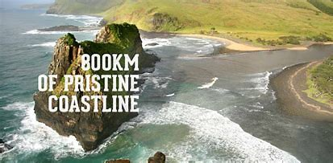
Tourism Sector
Activities | Status
Prevent collapse of the sector through a shared brand. | Operational
Unify the sector. | Operational
Support tourism administrations in boosting marketing efforts. | Operational
Marketing, including digital marketing to increase brand awareness and conversion. | Operational
Move towards experience marketing | Initiated

Slide 23
Enterprise Development:
Small Business Support
Activities | Status
Development of a database of SMME’s registered with Municipalities and strengthen stakeholder relations with Municipalities | Operational
Develop & roll-out Enterprise Development Ecosystem Programme | Initiated
Support Business incubation | Operational, Expansion
Implementation of the Provincial Informal Business strategy and implementation plan 2019-2024 | Initiated
Support Regulatory compliance | Operational
Partnerships for skills development and capacity building | Operational

Slide 24
Provincial Instruments for Economic Recovery

Slide 25
Economic InstrumentS
Programme Name | Description | Impact
Jobs Stimulus Fund | Funding for catalytic economic development projects. Incentivising the retention of jobs located within the Eastern Cape in key priority sectors which in turn will promote sustainable job creation across the province. | Conducive environment for industry development Opportunities for increased economic activities New jobs created
Local and Regional Economic Development Fund | Provide seed funding to enterprises which are not able to access funding from commercial banks and other developmental funding institutions. Provide co-funding support for enterprises, to ease debt burdens whilst increasing business viability and financial sustainability. | Promote and administer sustainable economic development and employment creation interventions by supporting Eastern Cape based entities to contribute towards economic growth

Slide 26
…Economic Instruments
Programme Name | Description | Impact
Isiqalo Youth Fund | The Isiqalo Youth Fund is targeting 100% youth owned enterprises operating or seeking to operate in the Eastern Cape. The Isiqalo Youth Fund offers a wider range of funding and technical support services across a wide spectrum of sectors to emerging youth owned enterprises. | Provide emergency funding support to qualifying youth owned-enterprises, to mitigate the impact of the Covid-19 crisis on youth erprises.
Imvaba Cooperative Fund | Advance the development of cooperative enterprises. | Advances employment and economic development in vulnerable communities impacted by the Covid-19 pandemic.

Slide 27
Economic Instruments cont.
Programme Name | Description | Impact
Comprehensive Agricultural Support Programme | Funding for primary production infrastructure, production inputs and capacity building (business & technical skills) for producers | Improved primary production with developing farmers participating in the mainstream of the sector, producing quality products and creating sustainable employment
SEZ Programme | World Class Industrial platform and incentives to investors locating in the zone (Foreign and Domestic) | Increased investments, economic growth and job creation
Critical Infrastructure Programme | Resourcing for Industrial Park development programme for investor landing on | Increased local manufacturing capacity and build local value chains for regional economic growth and job creation

Slide 28
CONCLUSION
Build on the resilience demonstrated by the economy
Adjust operations for improved competitiveness
Invest in innovation and product development
Agile economic infrastructure for investment landing and increased exports
SMME development
Inclusive and growing economy

Slide 29
CONCLUSION
Thank you/Enkosi/ Dankie

Slide 30


HEAD OFFICE
T: 043 605 7004/7007
Block 16, Business Village, Bhisho, 5605
Private Bag X0054, Bhisho, 5605

